Slide 1

Overview
Sean Harmeyer, John Penn
February 2025

Slide 2
Trick is written in C/C++ and Java.
Supports Linux, and MacOSX computer operating systems.

Slide 3
Trick is a NASA Open-Source simulation development framework for running time-based physics models.

Slide 4
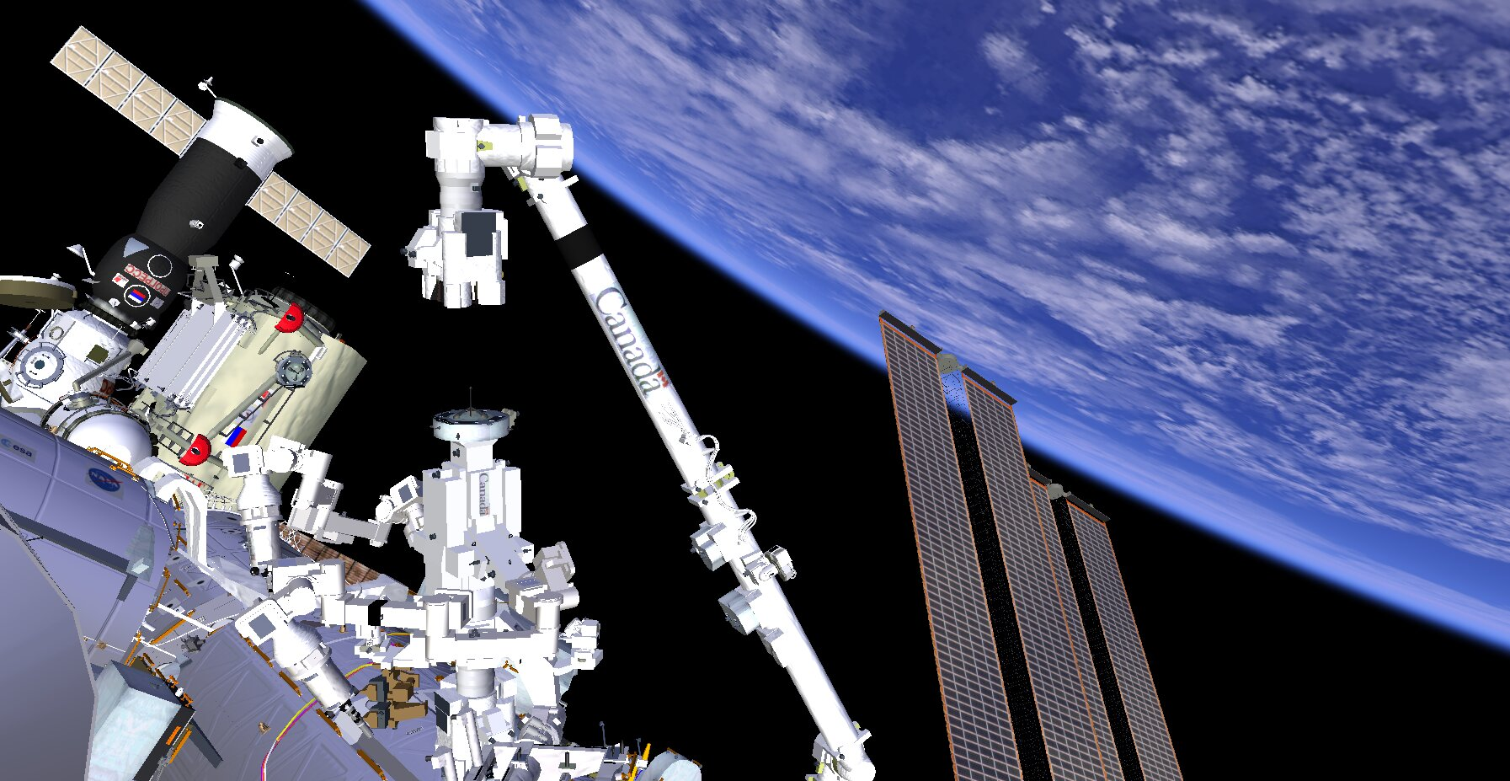
Special Purpose Dexterous Manipulator (SPDM)

Slide 5
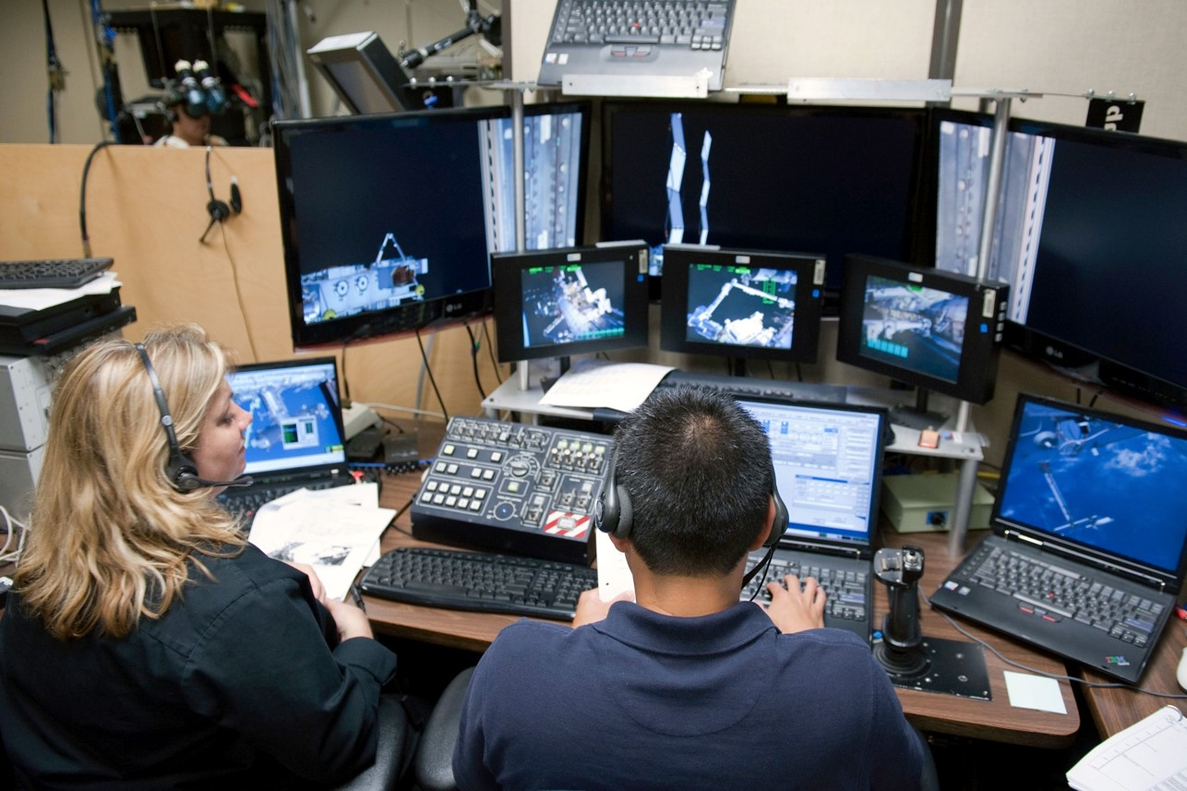
Virtual Reality Lab

Slide 6
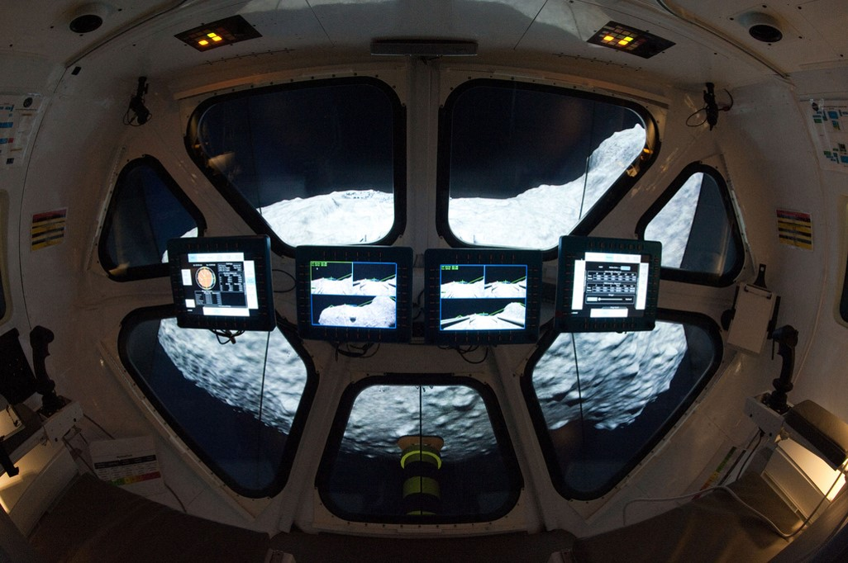
Multi-Mission Space Exploration Vehicle
MMSEV

Slide 7
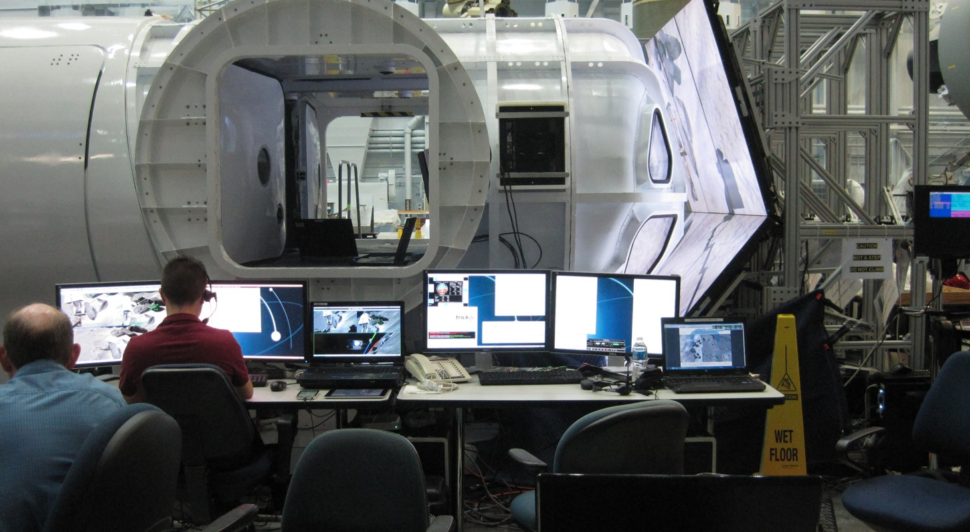
MMSEV

Slide 8
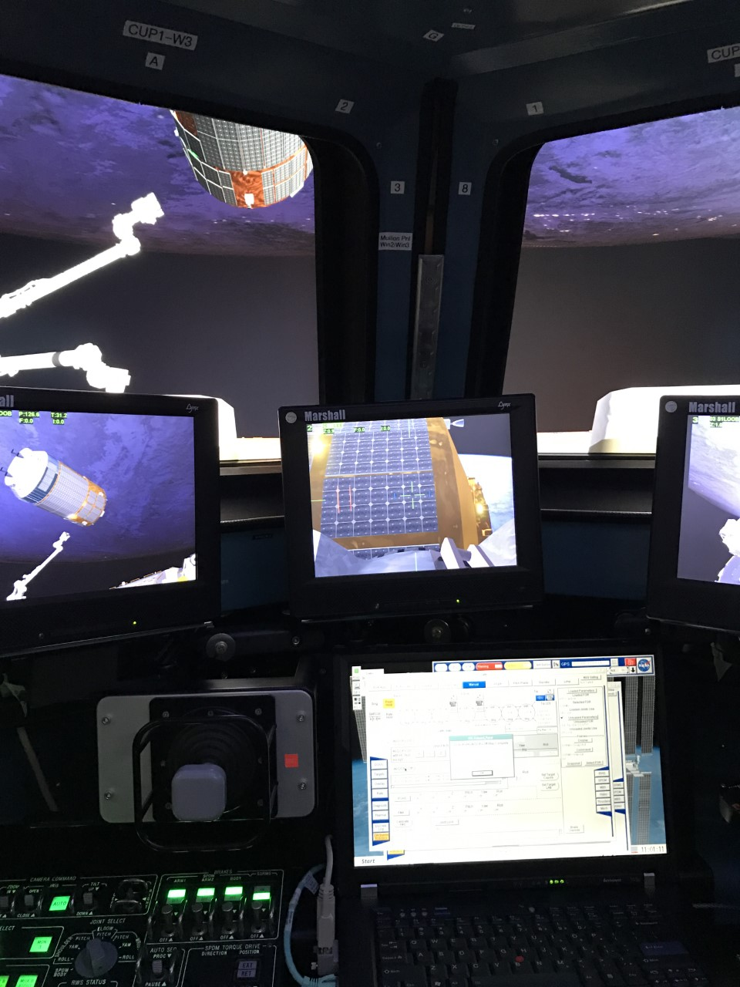
Robotic Trainer
ISS Cupola

Slide 9
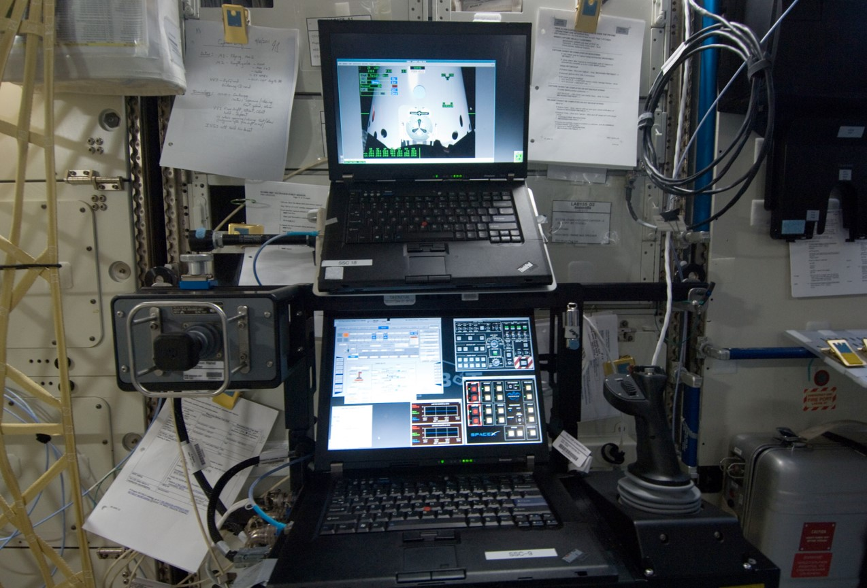
Robotic Arm Trainer Onboard International Space Station

Slide 10
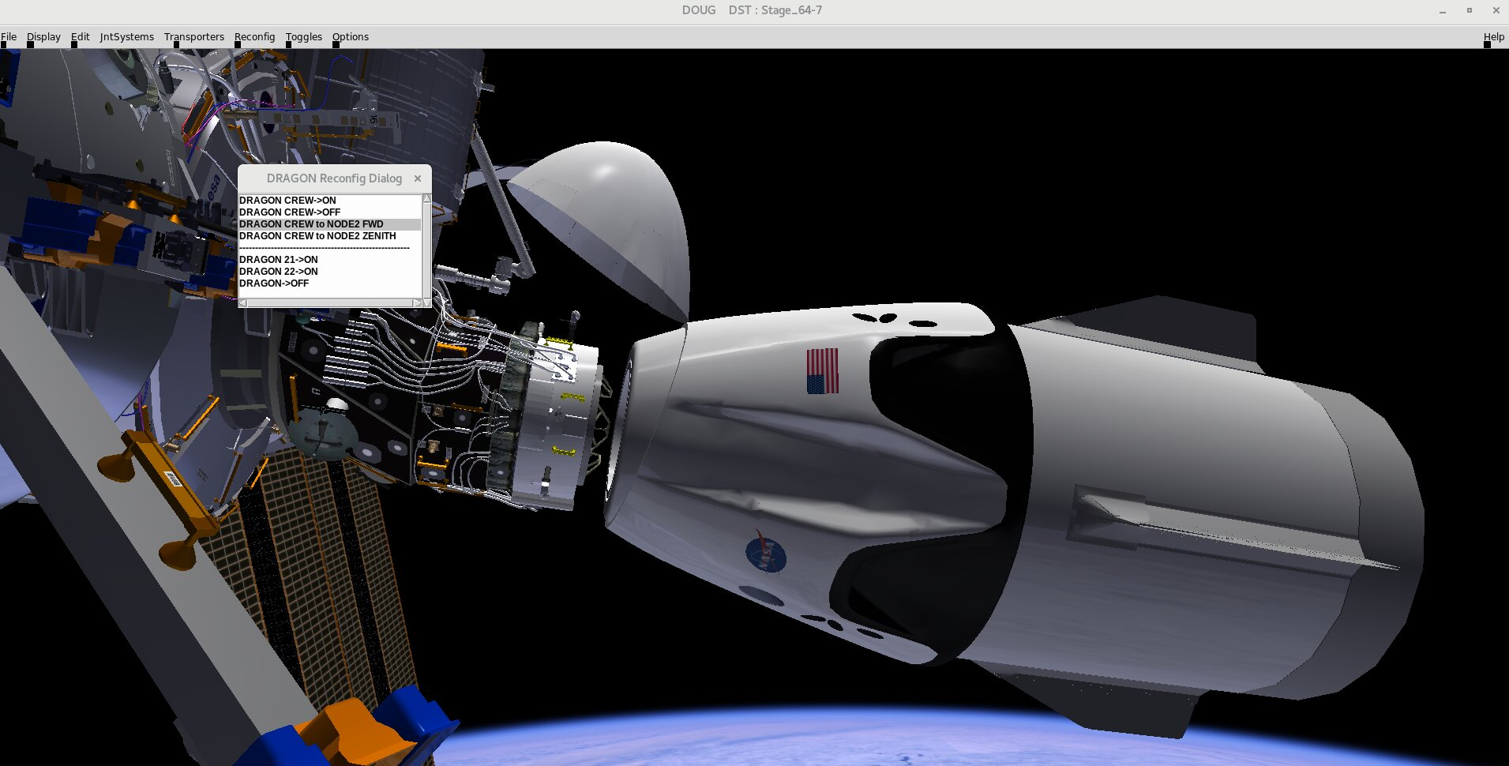

Slide 11
Simulation State 0
Model functions & Numerical Integration
Simulation State 1
Model functions & Numerical Integration
Simulation State 2
…
t₀
t₀ + 𝚫t
t₀ + 2𝚫t

Slide 12
General Strategy for Developing a Dynamic Simulation
“Dynamic” means “characterized by change”.
In a dynamic simulation things like position, and velocity, continuously change over time. Lots of other things might change as well depending on what you are simulating. The amount that something changes per unit of time is its rate of change, or time derivative.
For example:
Acceleration is a rate of velocity change .
Velocity is a rate of position change.
Current is a rate of change of charge.
If we know the rate of change of something, then we can add up all the little
changes over time to keep track of its value. This “adding up the little pieces” is called “numerical integration”.
This is the basic strategy for designing Trick dynamic simulations. We calculate rates, and then we numerically integrate them.

Slide 13
General Strategy for Motion
To determine the motion of an object we generally start with Newton’s Second Law:
F = ma
That is, force equals mass times acceleration.
This allows us to determine the rates that effect motion, that is: acceleration and velocity.
Solving for acceleration, we get :
a = F/m
This is the form of Newton’s Law that we generally use.
So, if we have a force acting on a mass, we can determine its acceleration. Then, we can then numerically integrate that acceleration to get velocity and then integrate the velocity to get position.

Slide 14
The Goal of Trick
The goal of Trick is to help simulation developers to focus on the algorithms and equations of their problem domain rather than repeatedly solving the same, time-consuming simulation architecture problems and reimplementing the same required capabilities.

Slide 15
Trick based simulations provide :
Automated binding/access to simulation variables
Job scheduling (calling functions at the right time)
Real-time synchronization
Ability to save and restore the sim state (checkpointing).
Data-recording
Network access to sim variables (variable server)
Numeric state integration
Python input processor
Tools for plotting recorded data
Many other supporting utilities and libraries.

Slide 16
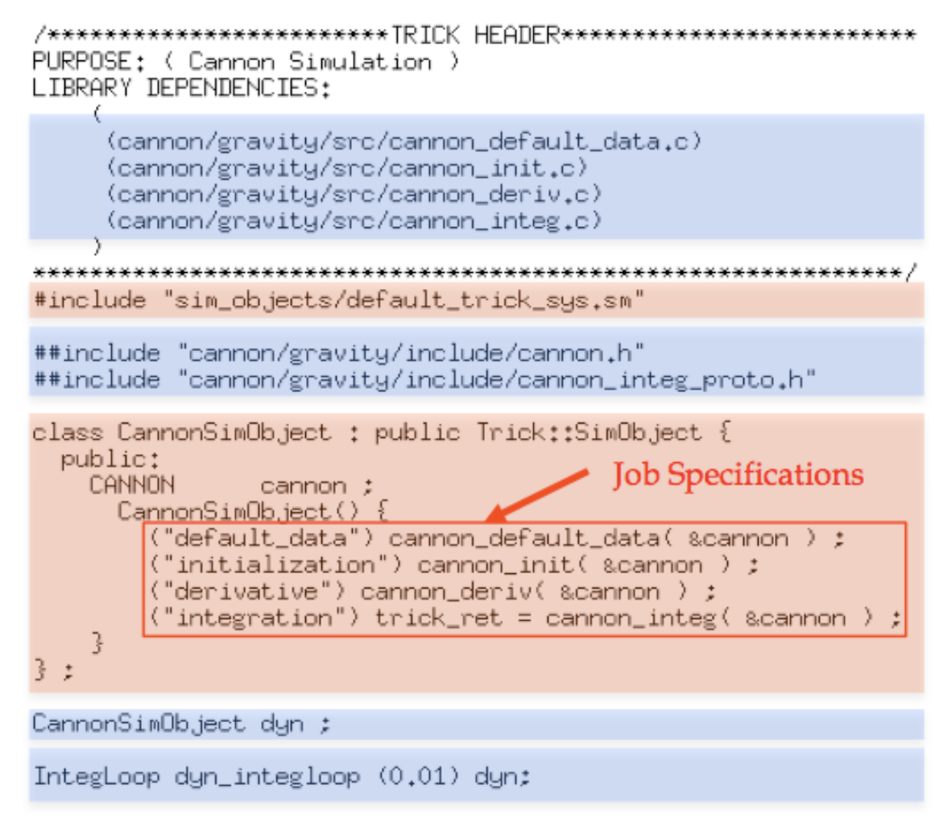
S_define

Slide 17
SIM_cannon_analytic/
models/
S_define
S_overrides.mk
RUN_test/
cannon/
include/
src/
cannon.h
cannon_analytic.h
cannon_analytic.c
cannon_init.c
cannon_shutdown.c

Slide 18
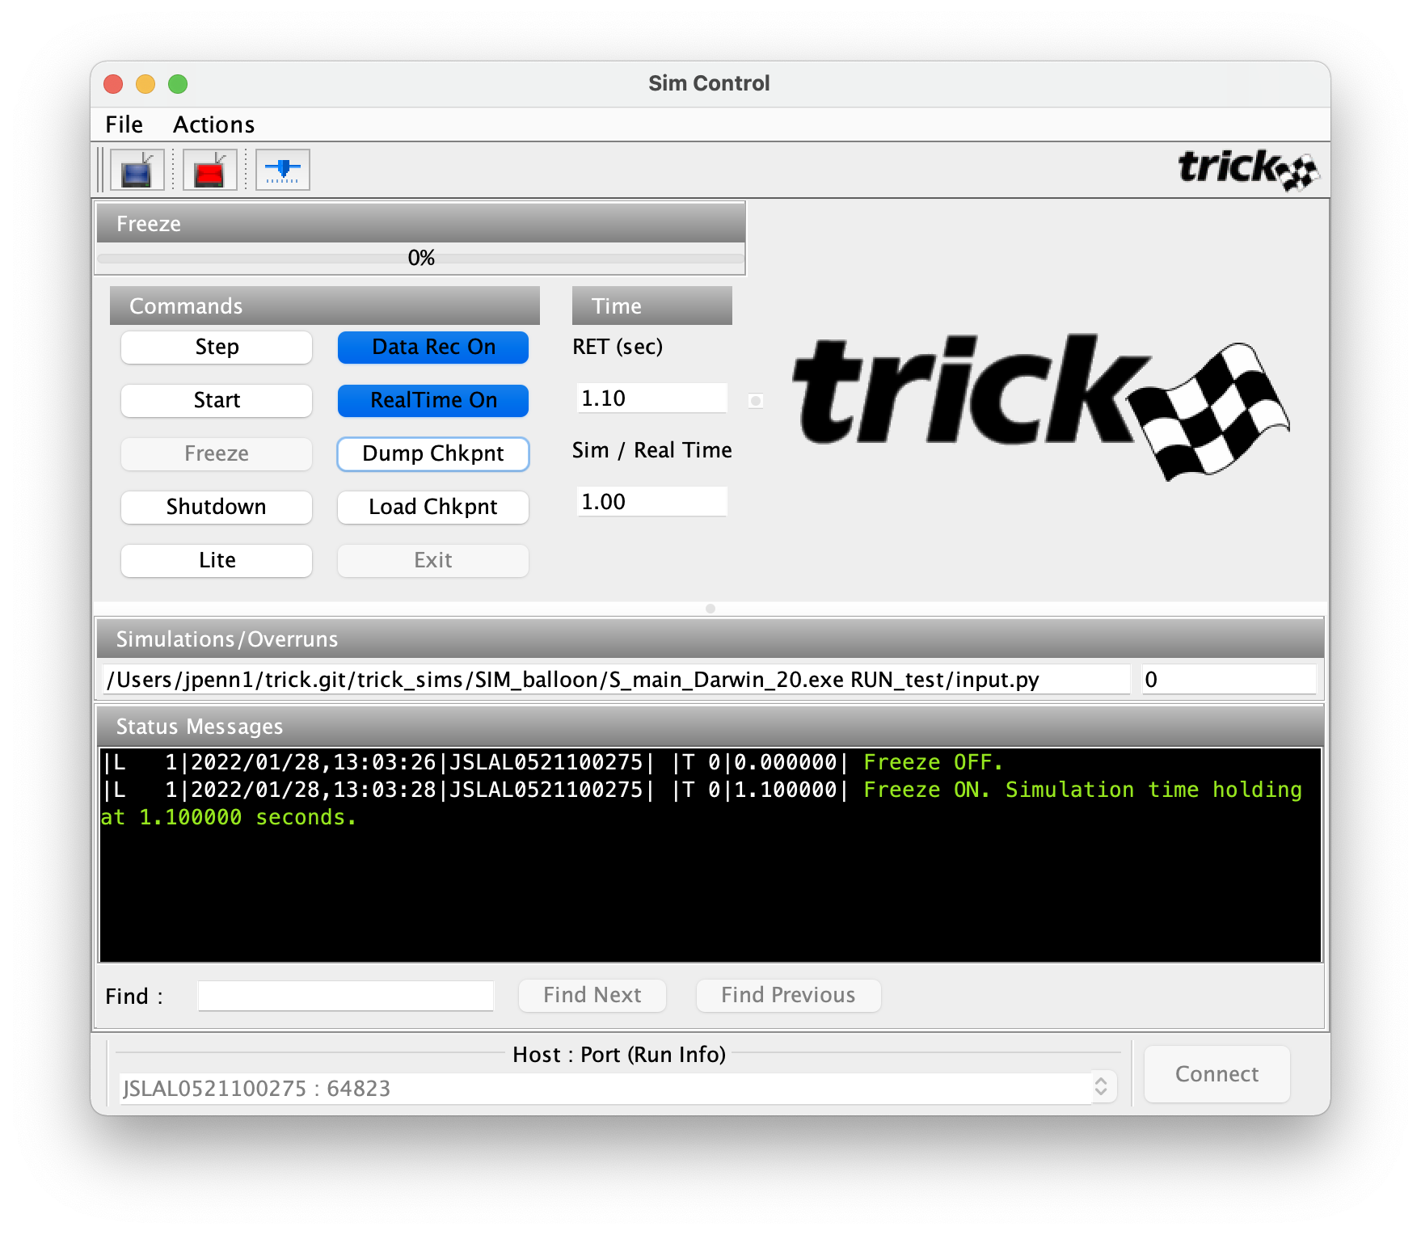
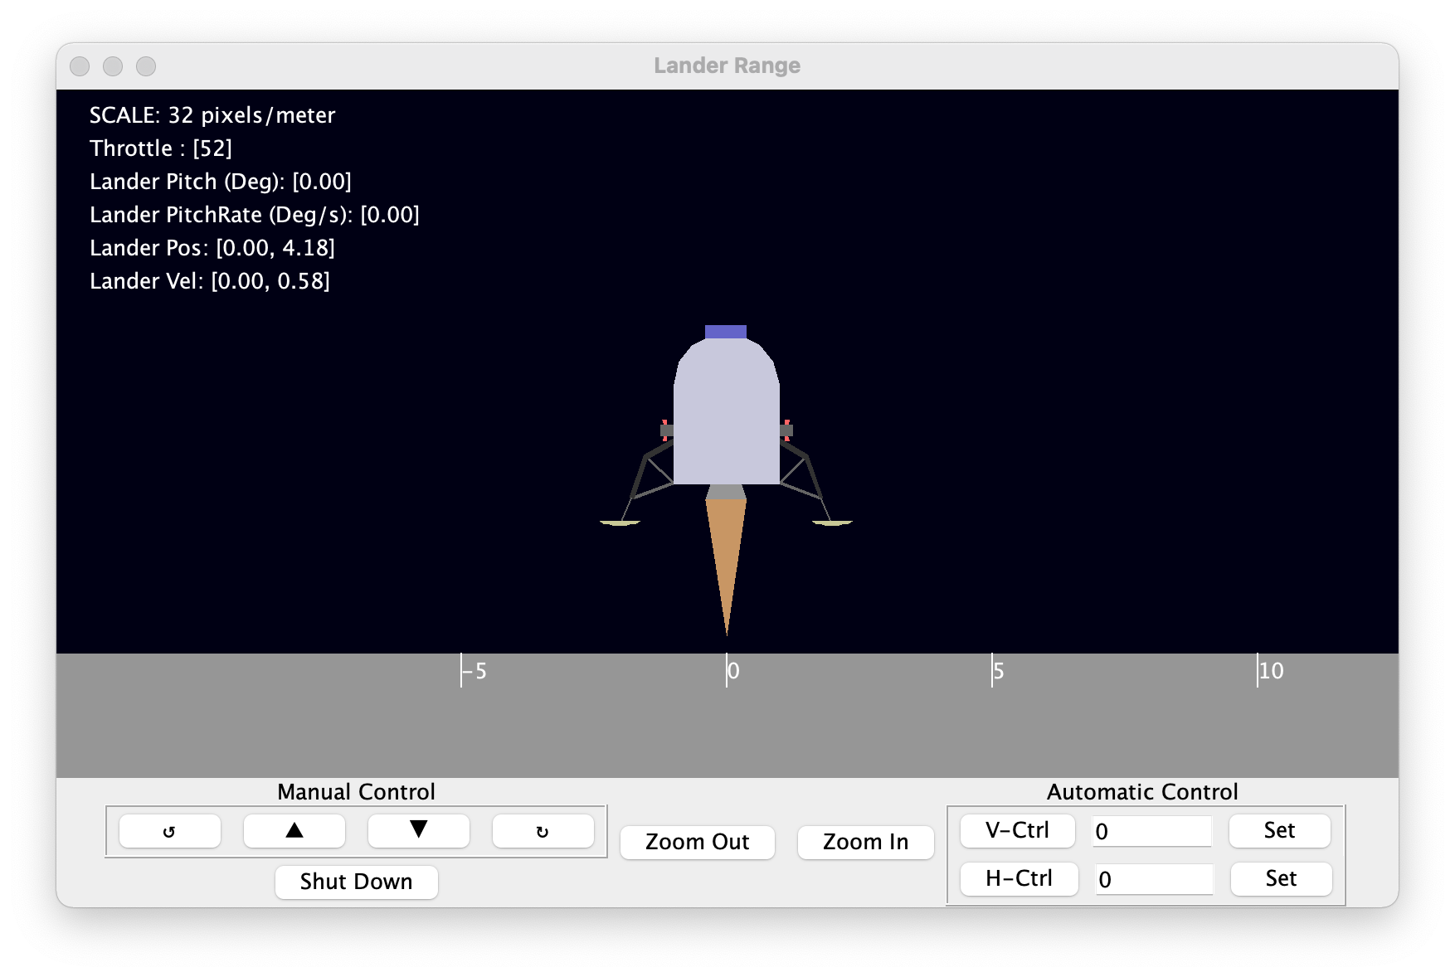
Trick Simulation Architecture
Initialization
Freeze
Input.py
Mode Check
Freeze Init Jobs
Freeze Jobs
Default Data Jobs
Input Processor
Initialization Jobs
Run
Shutdown
Shutdown Jobs
Mode Check
Top of Frame
Variable Server
Scheduled Jobs
Automatic Jobs
Time Advance
Integration Jobs
Data Recording Jobs
End of Frame
Variable Server Clients
Data recording files
(.csv, .trk)

Slide 19
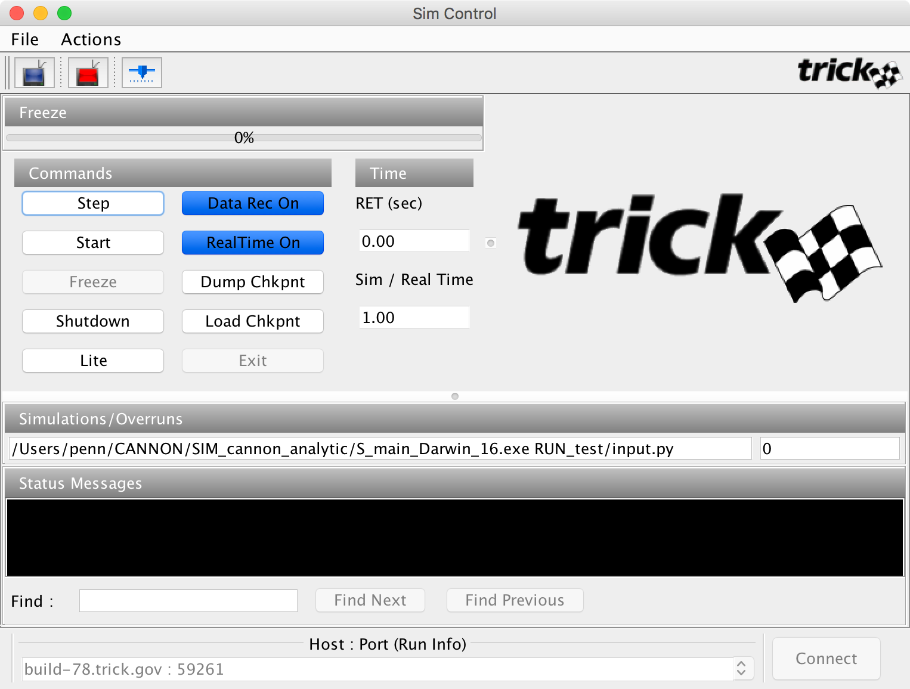

Sim Control Panel

Slide 20
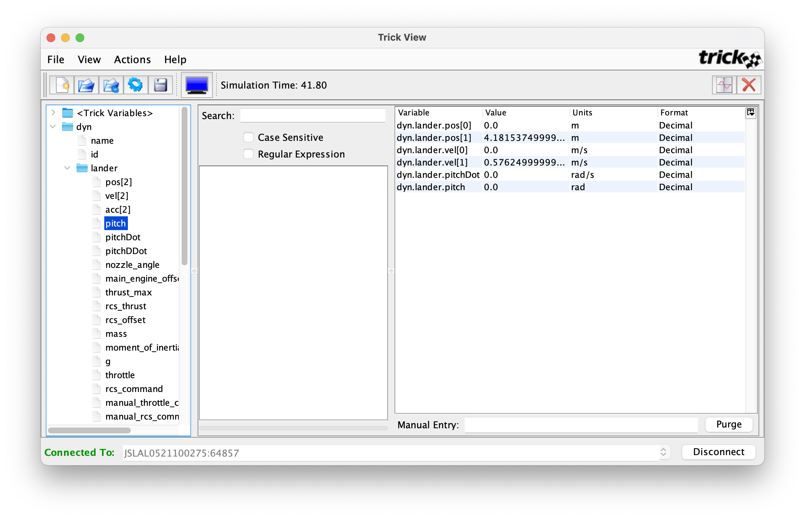

Slide 21
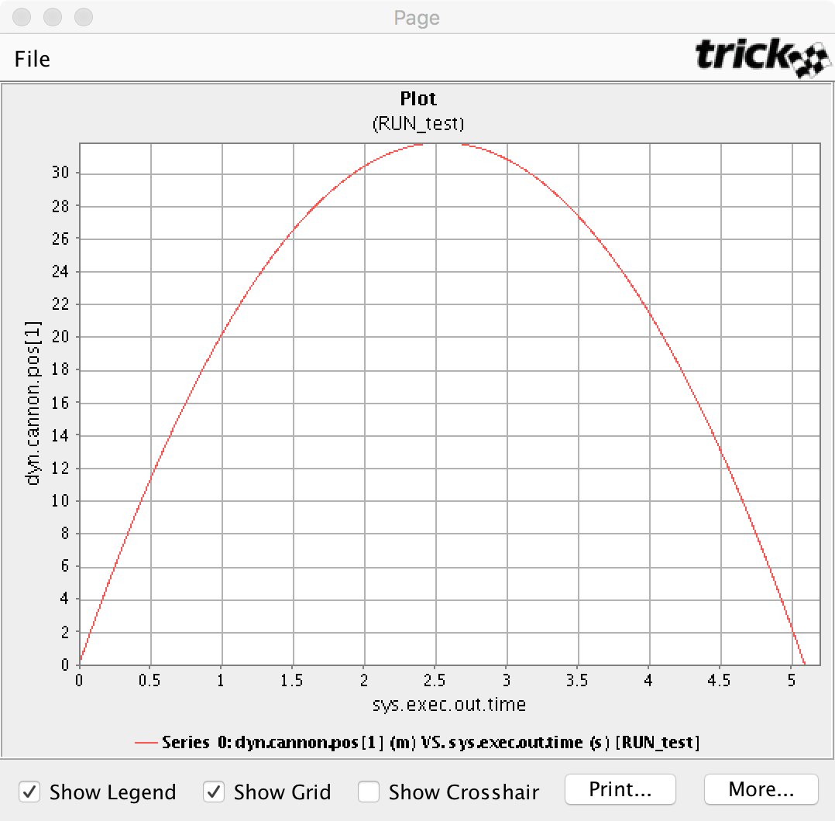

Slide 22
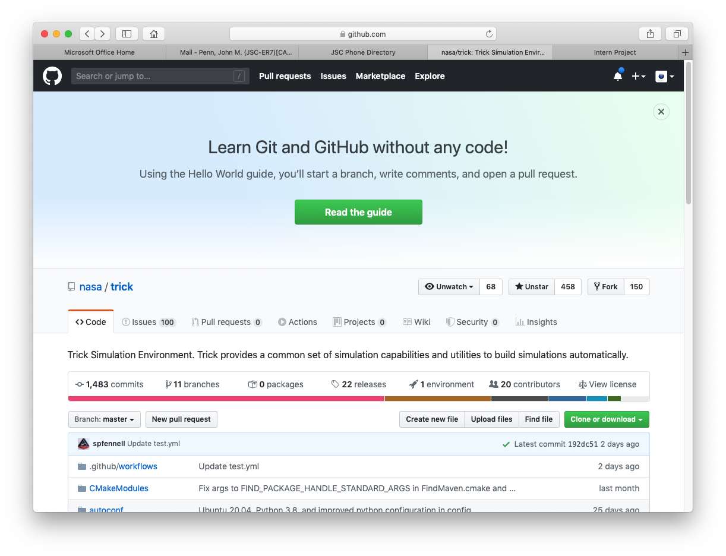
https://github.com/nasa/trick/
Trick is Open-Source

Slide 23
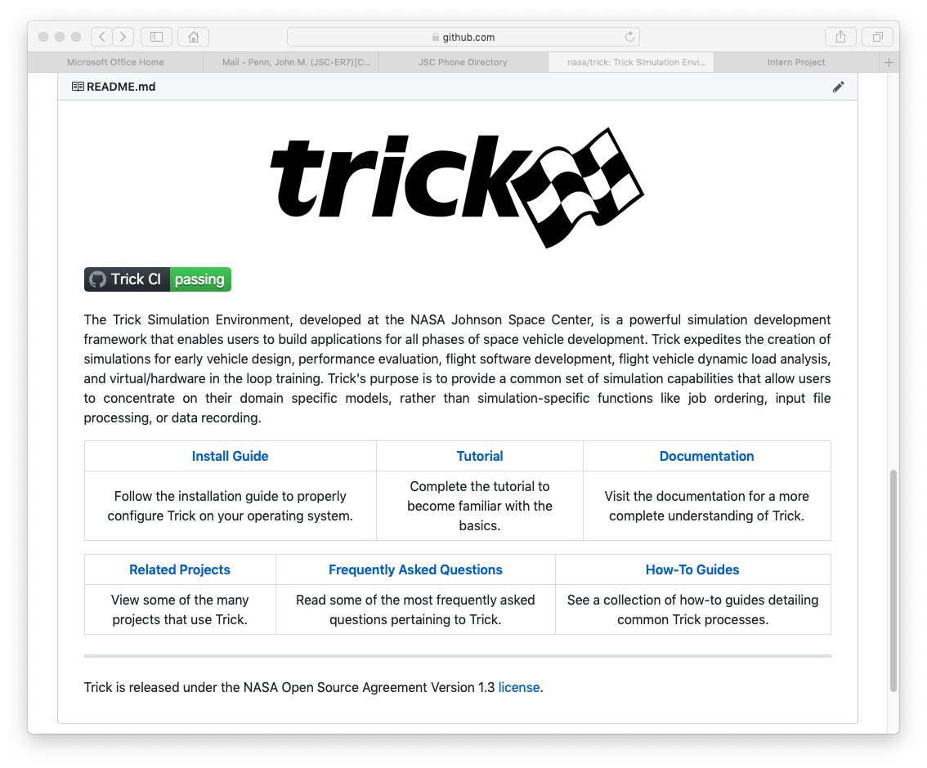

Slide 24
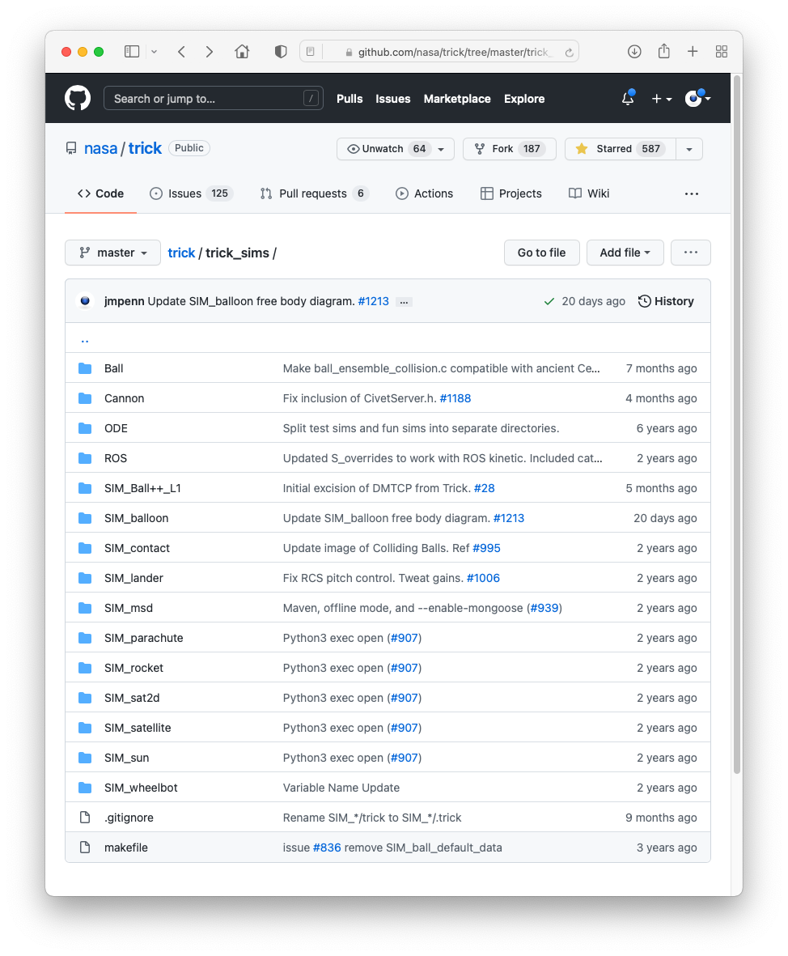

Slide 25
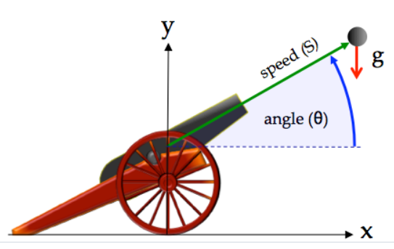
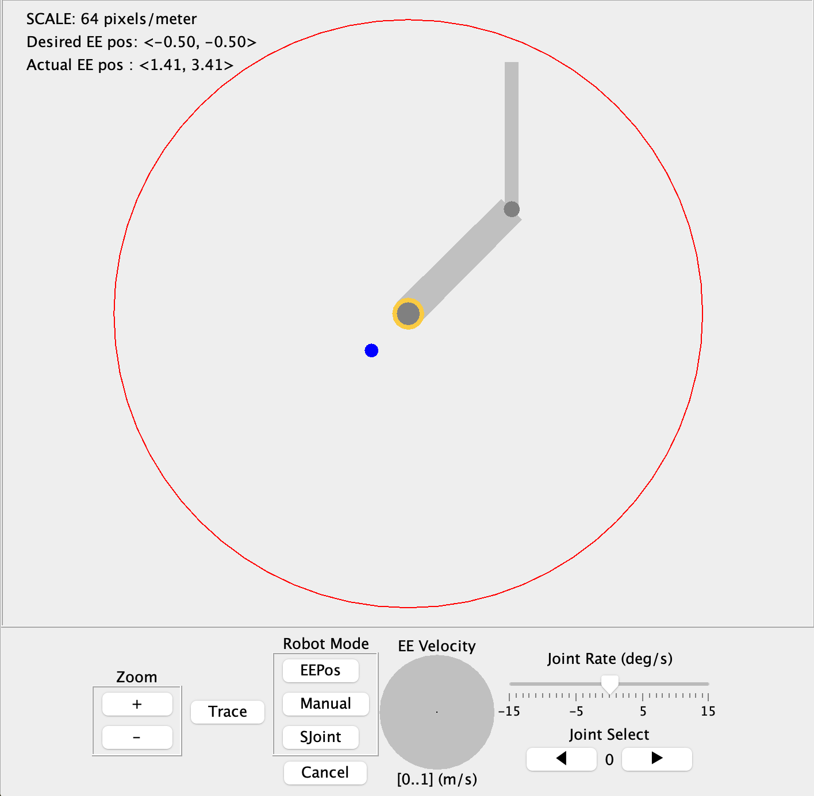
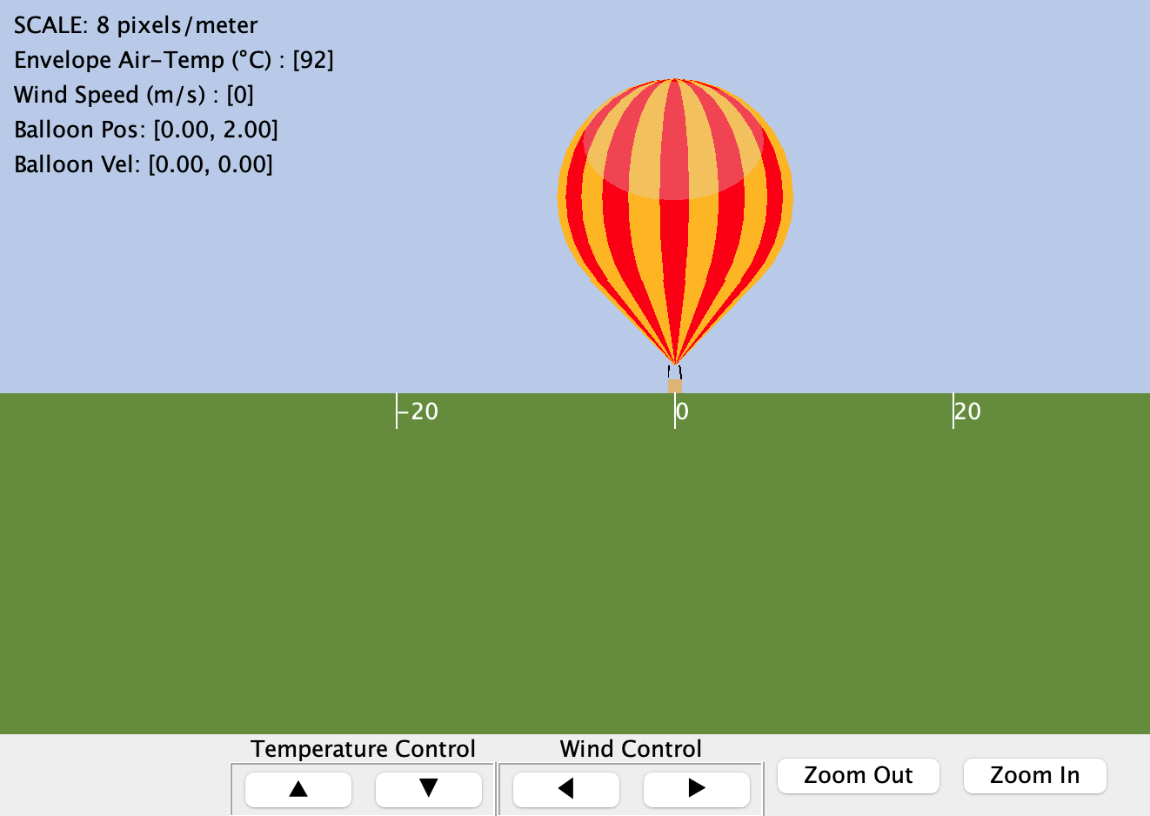
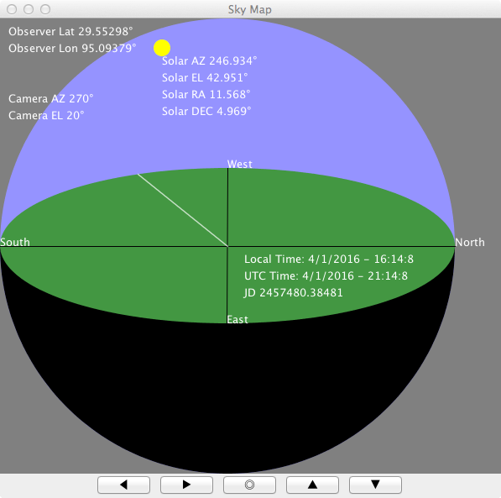
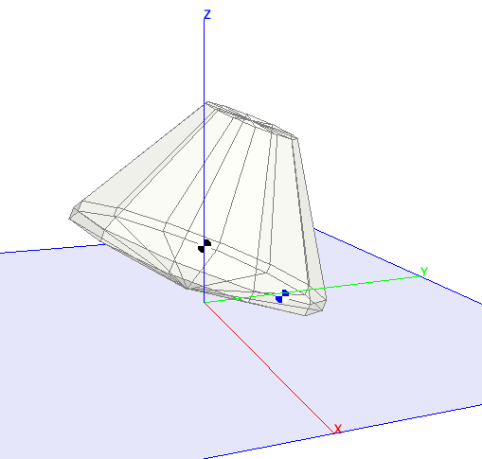
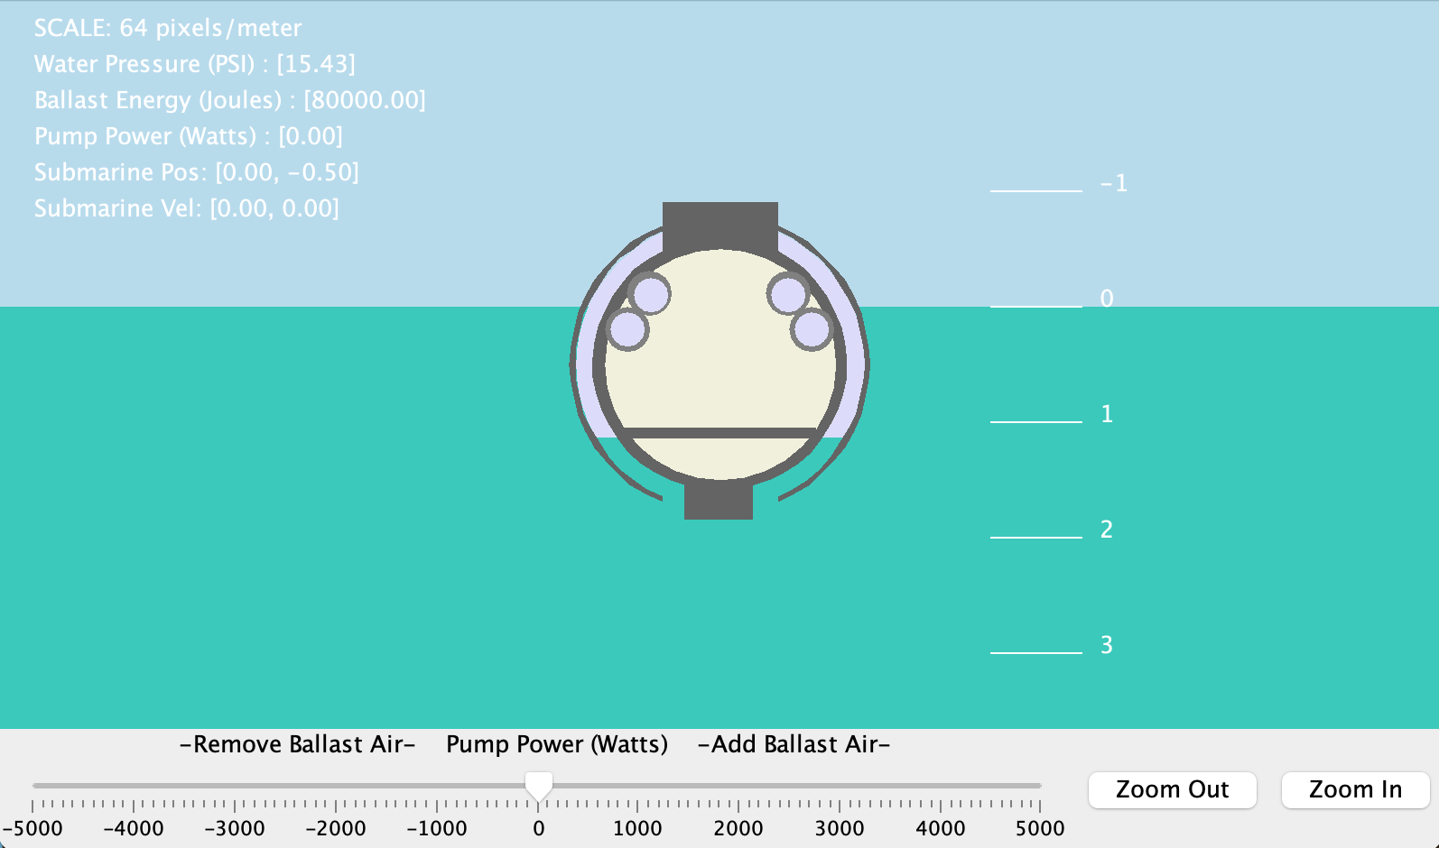
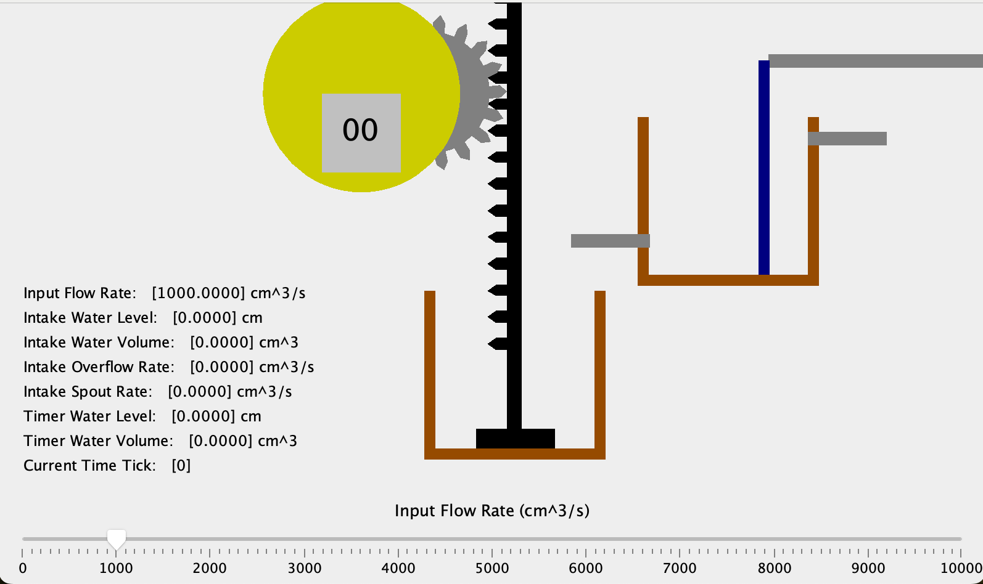
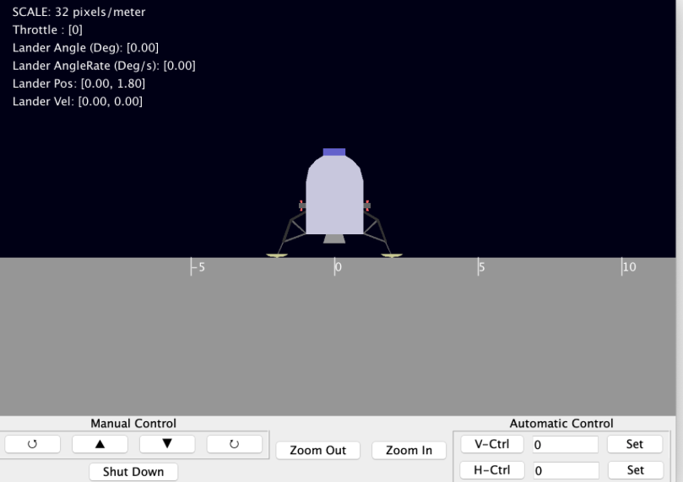
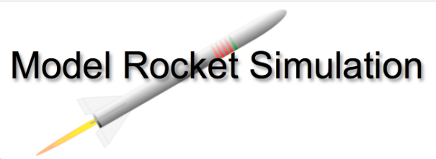
Lots of Example Sims

Slide 26
Enjoy!

